Slide 1






Petabytes and Nanoseconds
Distributed Data Storage and the CAP Theorem
FIN talk
Robert Greiner
Nathan Murray
August 21, 2014
Notes:
Welcome all, thanks for coming
Today, Nathan and I will be building off of some of the previous FinTalks and dive into distributed computing.
We’ll start this evenings journey with some theory that is important to keep in mind when building systems that have distributed components in them.
Next, we’ll talk about the trends corporations are going through who are having to deal with tough scaling problems.
And, finally, we’ll discuss how you can put some of this theory into practice at a client that is having scalability/performance issues.
Nathan and I intentionally left this presentation a little shorter than our allotted time to handle questions, so feel free to interrupt us throughout to get clarification or insert your point of view.
This talk will be much better with some audience participation, so be sure to speak up!
This also means that if it ends up being too boring, it’s your fault. Let’s get started!

Slide 2




All high frequency trading servers are connected to the NASDAQ network with the same length of cable, so that no party has a speed advantage
CHAPTER
1
The Problems
_
Your phone can add two numbers in the same time it takes light to travel one foot

Slide 3
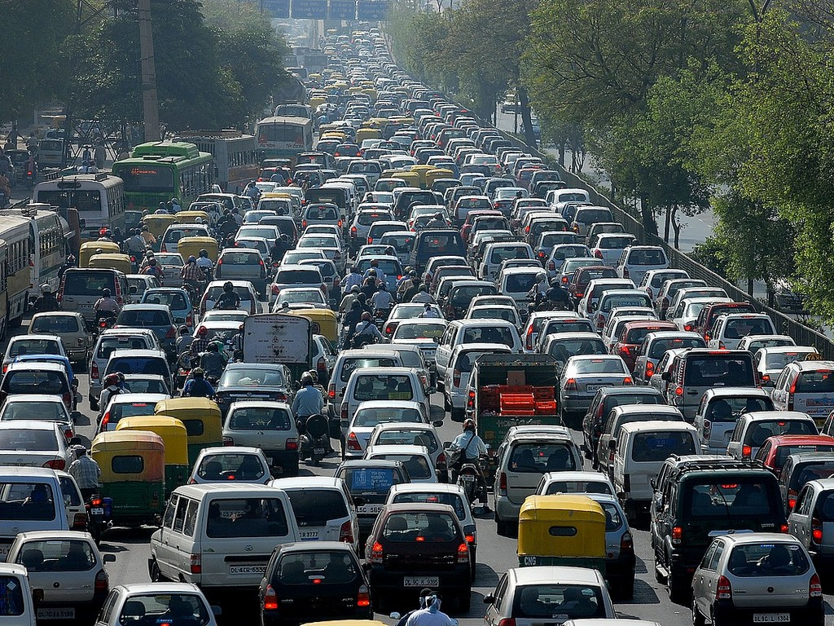

A Common Scenario
+
=
Notes:
The dig effect! Virality.
Other scenarios – increased work load. Processes that are order n squared complexity.
Why is this common?? Because it solves 90% of most business problems.
I have a friend who has business critical reports and processes running in Access macros nightly through scheduled tasks. A previous client hooked up a million dollar robot to a $300 Dell desktop.

Slide 4
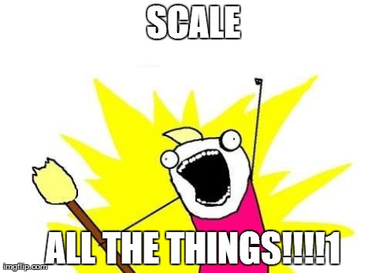
The Solution: Scale All the Things!!1

Slide 5

Why should we scale?
Throughput
Latency
Storage
Reliability
Notes:
Throughput – when you just need more transactions per second
Latency – responses are not getting back quick enough
Storage – data is growing exponentially. Businesses can have a competitive advantage by using it
There are physical bottlenecks for this setup that cannot be changed.

Slide 6

The Solution?
Add more web servers
Add a load balancer
Tune the DB. Indexes, SPs, etc.
Notes:
When you need to scale, it’s common to start scaling at the web tier. HA is built it to this model. RDBMSs are very resilient (and expensive for a reason). Most use cases don’t need anything more than an RDBMS.
For a data store, there are hard limits. You can only read so much fast from disk. You can only write so quickly from disk. Specifically, around 10K transactions per second is where you start to see a bottleneck on an RDBMS.

Slide 7
There’s a new bottleneck
Generally an RDBMS can become a bottleneck around 10K transactions per second
Bottleneck!
Notes:
When you need to scale, it’s common to start scaling at the web tier. HA is built it to this model. RDBMSs are very resilient (and expensive for a reason). Most use cases don’t need anything more than an RDBMS.
There are physical bottlenecks for this setup that cannot be changed.
A spinning disk can only spin so fast. E.g. data can only be written to disk at a set speed.
SSDs help with this immensely, but even so, you are changing the physical structure of matter, which takes time.
Speed of light and processing. A TCP packet takes a certain amount of time to move across the wire.

Slide 8

Next Step… Distribute Your Data
Each web server can talk to any data storage node
Dynamo-ite!
Nodes distribute queries and replicate data – lots more complexity!
Notes:
Complex – no joins.
Distributed data is unknown/unmet. Heard about map/reduce, Hadoop, etc.

Slide 9

Cluster = Additional Complexity
How do you add a node to the cluster?
If a node permanently fails, how do you recover?
How do you upgrade the cluster and keep it available?
If a node can’t talk to another node, what action can you take?
How do the web servers know which node to use? Do they retry if one fails to respond? If so how long to they wait?
We’ll focus on this

Slide 10

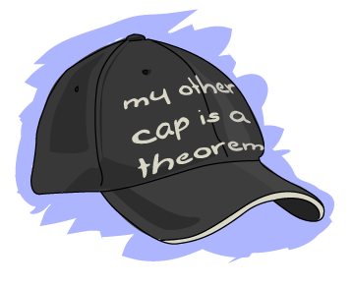
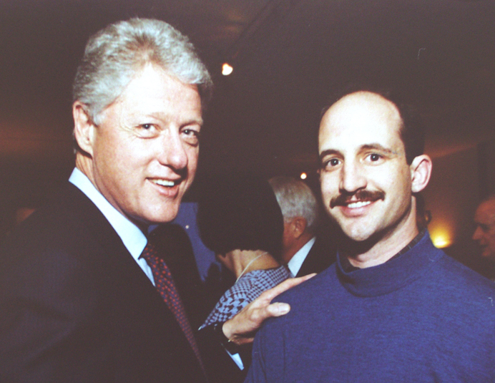
Enter the CAP Theorem!
This guy created the CAP Theorem
This guy’s
VP Invented the internet
Notes:
Eric Brewer, talk in early 2000s about distributed computing.
UC Berkley

Slide 11
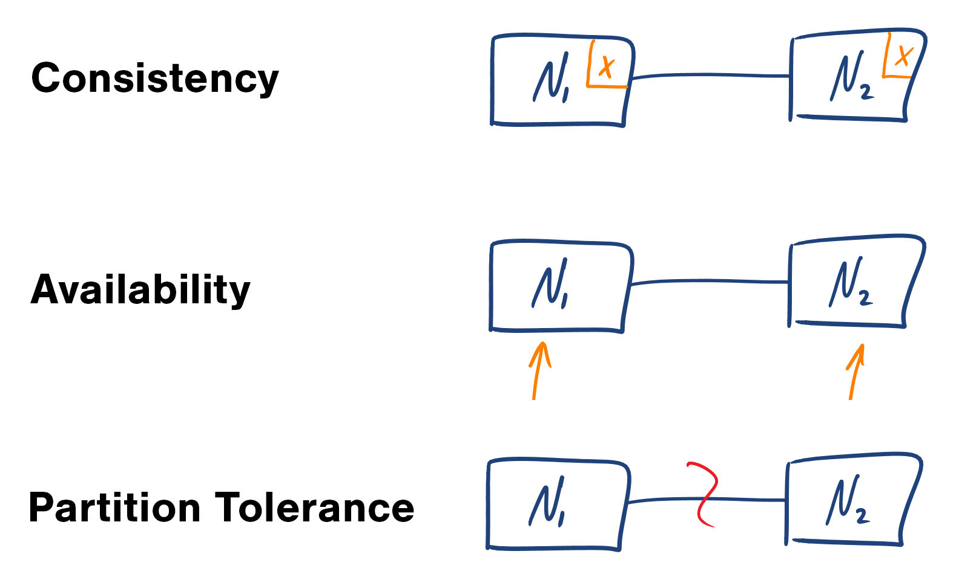
CAP Theorem: Defined
Within a distributed system, you can only make two of the following three guarantees across a write/read pair

Slide 12
Guarantee 1: Consistency
Note: not the same as the C in ACID!
When a value is written, and then fetched, I will always get back the new value
_
Notes:
Atomicity
Consistency
Isolation
Durability

Slide 13
Guarantee 2: Availability
Note: not the same as the A in HA!
When a value is written, a success message should always be returned. If a subsequent read returns a stale value, or something reasonable, it’s OK.
_
Notes:
Talk about Amazon’s adding to cart during a tornado.

Slide 14

Guarantee 3: Partition Tolerance
Note: nothing to do with BAC!
The system will continue to function when network partitions occur – OOP != NP.
_
Notes:
8 fallacies of distributed computing – Peter Deutsch as Sun Microsystems
The network is reliable.
The latency is zero.
The bandwidth is infinite.

Slide 15
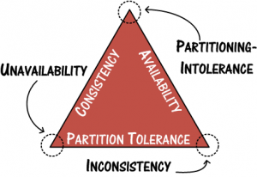
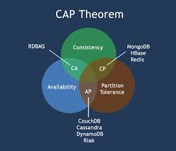
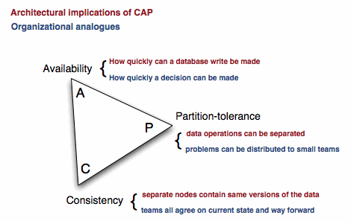
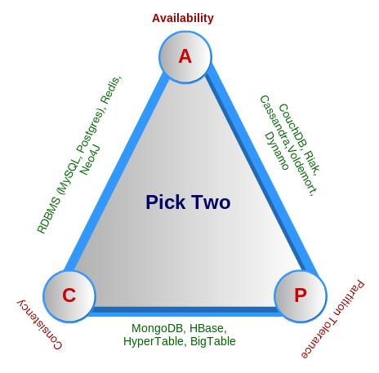
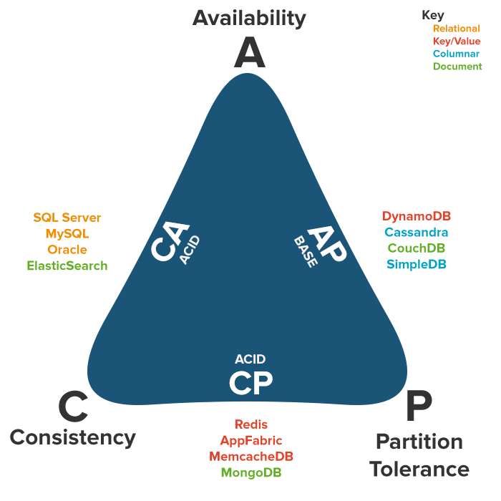
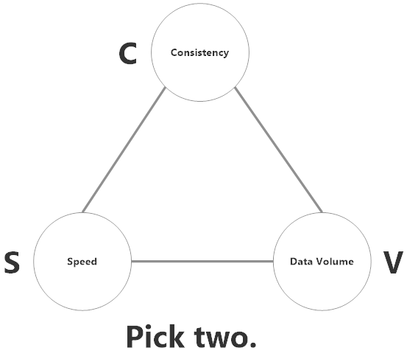
CAP Triangle
The CAP Theorem is explained as a triangle
C, A or P: Pick two
This is true in practice, except…

Slide 16


When choosing a distributed system…
vs.

Slide 17
… You Can’t Sacrifice Partition Tolerance!
Distributed
(a.k.a. Partition Tolerant)
Available
OR
Consistent
NOT Distributed
(a.k.a. NOT Partition Tolerant)
Available
AND
Consistent
_
_

Slide 18
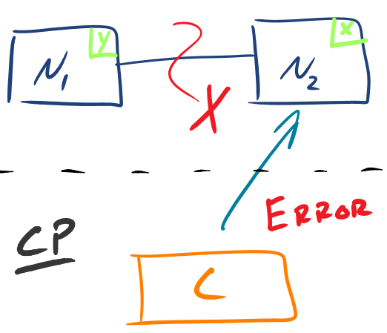
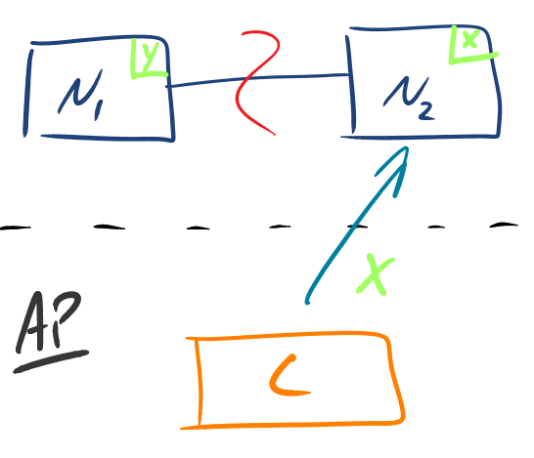
CP vs. AP
Synchronous.
Waits until partition heals or times out.
Asynchronous.
Returns a reasonable response always.
Notes:
Provide some examples?
For instance, talk about the systems that are implemented in this way.

Slide 19


CP vs. AP
Synchronous.
Waits until partition heals or times out.
Asynchronous.
Returns a reasonable response always.
At a bank, you get a deposit receipt after the work is complete
At a coffee shop, you get a receipt before the work is complete
Notes:
Provide some examples?
For instance, talk about the systems that are implemented in this way.

Slide 20
CHAPTER
2
When do companies care?
_

Slide 21





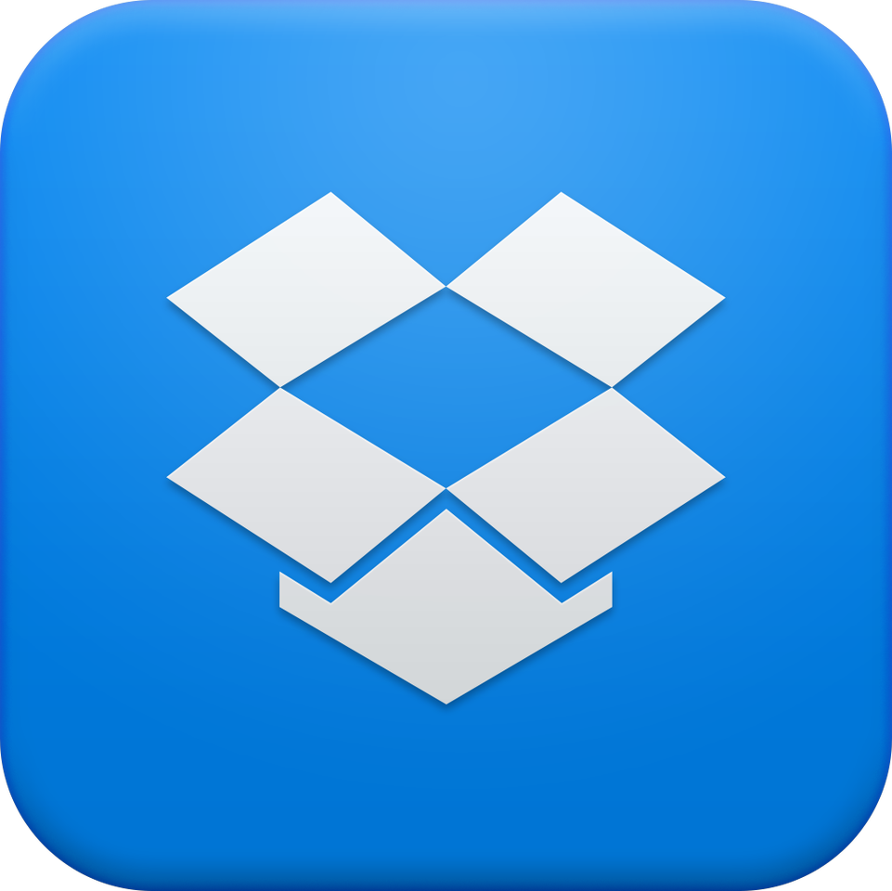



Companies care about internet scale

Slide 22
Distributed Storage Past
2004
Google’s Map Reduce paper published
2006
Google’s Big Table paper published
2007
Amazon’s Dynamo paper published
2008
Yahoo runs search on Hadoop
2008
Facebook open sources Cassandra
2009
Yahoo open sources Hadoop
2010
Azure Table Storage released
2012
Google’s Spanner and F1 papers
2013
Amazon releases DynamoDB inside AWS
2014
Google’s Mesa paper published
2015
????
2008
Bitcoin paper published
Notes:
Google had one of the first modern distributed storage engines – BigTable and MapReduce
Amazon followed up with Dynamo
2009 – Yahoo opens up Hadoop

Slide 23
Looking forward
Open source implementations of more sophisticated storage systems
Managed services with more advanced capabilities
Google Cloud versions of F1, Spanner, or Mesa?
NoSQL + SQL
Distributed data storage in untrusted environments

Slide 24
CHAPTER
3
How does this affect me
_

Slide 25
Even our most “legacy” clients are already starting to care about internet scale:
_

Slide 26

Notes:
Imagine with me

Slide 27
Scenario
Client = Energy Retailer (Independent Sales Force)
Sales Agent captures info about potential customer
Price generated on-demand based on daily rate curve
Quote no longer valid at midnight
Each night, rates are updated based on new rate-curve
Used to take 4 hours
Now takes > 24 hours (Due to increased demand)

Slide 28
Current State
Bottleneck!

Slide 29
Solution Strategy
Assess
Select non-performing work streams
Filter – (Could/Should)
Strategize
Identify Bottlenecks (CPU/RAM/Network)
Optimization strategy
Implement
Build
POC
Analyze business performance needs
Technology Selection
Performance Baseline / Load Test
Prioritize
Load Test
Optimize

Slide 30
Optimize Code
Scale Up
Scale Out
Managed Service

Slide 31
Optimize Code Level 1
Least organizational impact
No architecture changes required
Use existing development processes
Risky – Code may be fine
Expensive – Dev Resources
Time Consuming – Dev + Deploy

Slide 32
Scale Up Level 2
C/A
Easiest solution
Utilize existing infrastructure
Little/no architecture changes
Low probability of network partitions
May not solve the problem long-term
Hardware limitations
Non-linear improvement (2x RAM != 2x Performance)

Slide 33
Scale Out Level 3
A/C
Highest throughput
Improved system up-time
No single point of failure
Linear performance increases
Use commodity hardware – Hard to scale-up CPU
Increased infrastructure / system complexity
Increased probability of network partitions
Automation complexity

Slide 34
Managed Service Level 4
C/A
A/C
Low barrier to entry
No additional hardware investment required
Treat as extension of existing data center
Appliance configuration
Globally redundant (cloud)
Most organizational change
Less control and customization
Built-in redundancy and innovation

Slide 35

Pick One (Or More!)
Optimize Code (Level 1)
Scale Up (Level 2)
Easiest solution
Scale Out (Level 3)
Highest throughput
Managed Service (Level 4)
Low barrier to entry
No architecture changes required
Use existing development processes
Risky – Code may be fine
Expensive – Dev Resources
Time Consuming – Dev + Deploy
Least organizational impact
Utilize existing infrastructure
Little/no architecture changes
Reduce probability of network partitions
May not solve the problem long-term
Hardware limitations
Non-linear improvement
Improved system up-time
No single point of failure
Linear performance inc.
Use commodity hardware
Increased infrastructure / system complexity
Increased probability of network partitions
Automation complexity
No additional hardware investment required
Treat as extension of existing data center
Appliance configuration
Globally redundant (cloud)
Most organizational change
Less control and customization
High innovation

Slide 36

First Attempt
Notes:
The architecture here doesn’t change much
Leave everything alone that isn’t part of the bottleneck

Slide 37
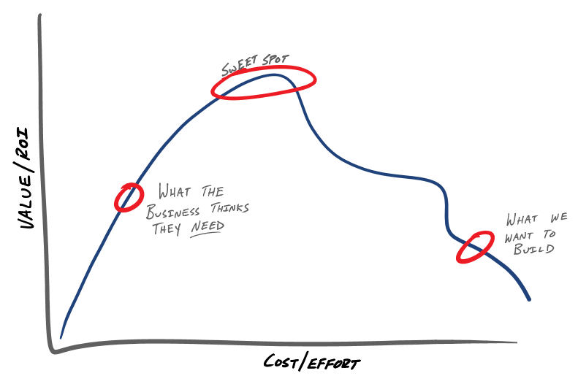
Good Enough?

Slide 38
Taking It to the Next Level

Slide 39

The Best Solution?

Slide 40
What Would YOU Do?

Slide 41

Fin’
robert.greiner@parivedasolutions.com
nathan.murray@parivedasolutions.com

